Slide 2
Introducing Super HEN!
Cost Savings: Steam Cost from $280 million/yr to $120 million/yr (double check figures)
HPS/LPS cost = 73% of OPEX! Large cost saving potential
Other Advantages:
Extra hot streams available for heat integration
Water at the bottoms exits at 220C approx → can preheat the DEAmine before sending to stripper system (further reduction in steam duty)
No LPS required
High purity methanol (99.95% obtained – HPLC grade)
Fetch higher prices

Slide 3
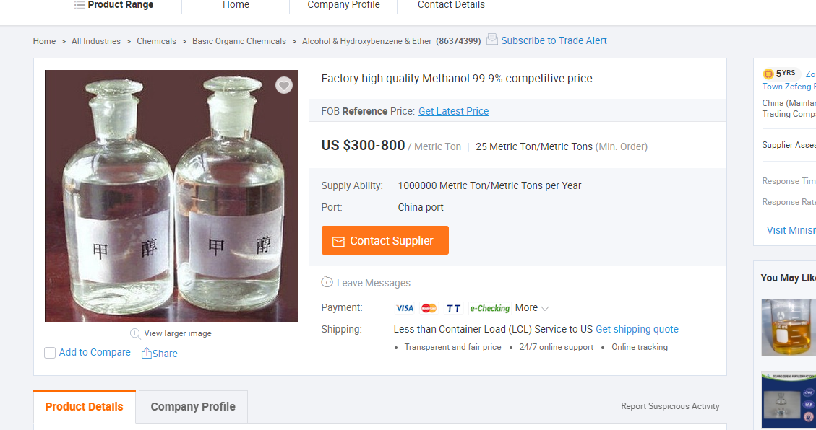
Why high purity MeOH? (stay competitive)

Slide 4
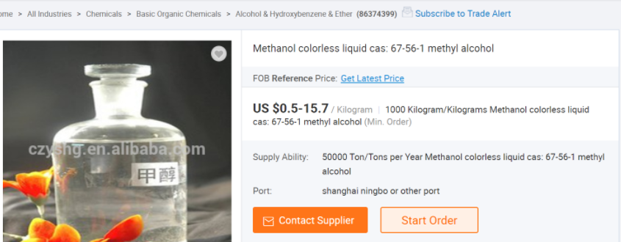
Purity: Key to Profitability

Slide 5
How?
Heat Integration of Distillation Columns
Stripper Columns and MeOH Distillation columns both make use of HPS/LPS for heating
Solution:
High Pressure Distillation Columns (~24 barg) for MeOH distillation
LPS generated from condenser supplies remaining steam in amine regenerators
HPS heats reboiler of MeOH columns

Slide 6
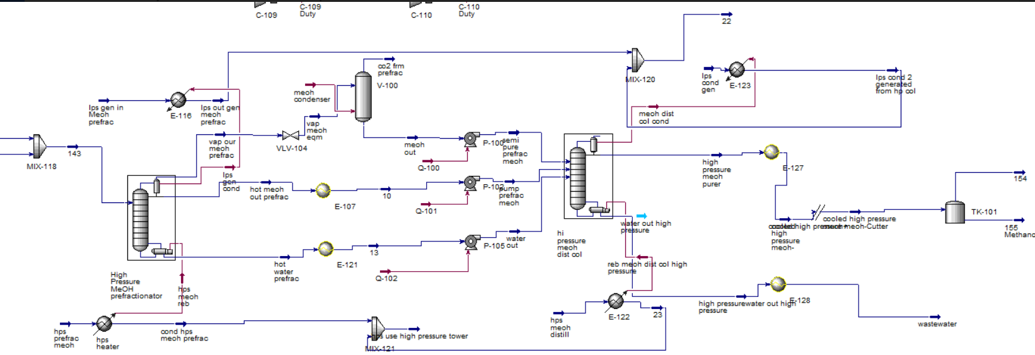
Process Diagram: High Pressure Columns up to 99.8% (answers Question for FYDP)

Slide 7
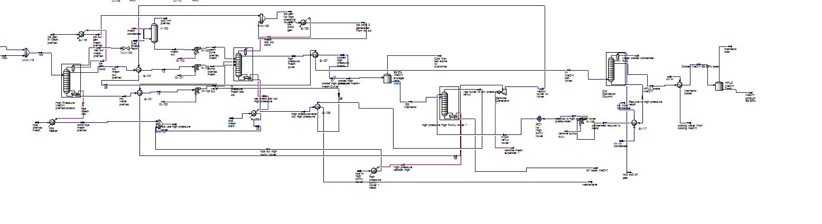
Possible Process Diagram: from 99.8% to 99.95% (to be profitable in current market)

Slide 8
Profitability Analysis
Taken into account: high pressure towers, condensers, reboilers, expanders, spares and overcosted them for safety
Total additional CAPCOST: $169 million (on top of $71 million previously)
Total CAPEX: $240 million
More Robust analysis
Hydrogen recovery system costed as fresh H2 feed (overestimation) → additional 100 kg/h H2

Slide 9
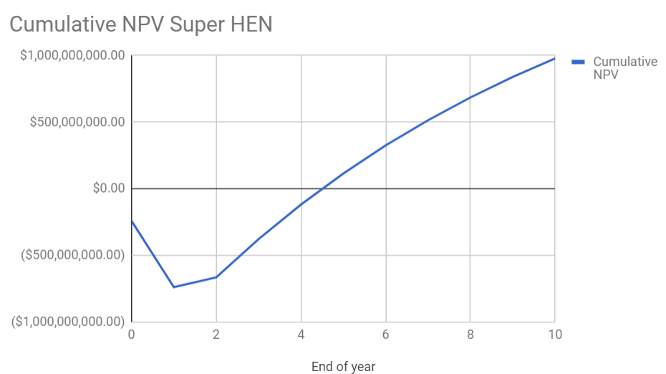
Profitability Analysis: Worst Case Scenario
Real Life Hydrogen Prices:
Eg. Renewable Hydrogen $10/kg (NREL)
Break Even Price at Year 5:
$3.30 average price per kg MeOH
At $5/kg, break even price at yr 5: ~$2
At $3/kg, break even price at yr 5: ~$1.20
At $1/kg, break even price at yr 5: ~$0.90
Such prices were not possible in other setups!

Slide 10
Analysis and Assumptions
Key Point of Concern: Sufficient Quantities of MeOH is possible to sell at high prices:
This is only possible with the right business connections
Quantities of HPLC/Reagent grade MeOH Demanded may be limited

Slide 11
Still Room for More Profits!
Reflux ratio and feed stage not yet optimised (maybe 10% savings estimate)
Prefractionation setup to reduce stripper reboiler duty by up to 30%
Use of oversized Diabatic FBRs for maximum HPS generation (virtually all heat of reaction used for HPS generation: maximum exergy – Gibbs free energy - savings)
Other heating for high temp comes from new hot streams/reactor effluent
Pinch Analysis to be redone for this new system (another 10% or so)
Optimisation of this setup to minimise Jcost (shorter breakeven times)

Slide 12
Thank You!
Q&A time

Slide 13
Appendix: Tower CAPEX
CAPEX:
3x High Pressure Towers Expensive: estimate $19 million each (next most expensive: $1 million, up 10-20x for estimation with spares, reboiler, condenser, piping, P&ID, for 30 barg safety) total: $57 million
1x low pressure tower incase old tower cannot be used: $3 million
6x heat exchangers: $1.6 million a piece = $10 million (again normally, heat exchangers cost $700,000-$1 million each)
4x Tanks (2+2 spares): $5 million each
2x Expander (1+1 spare): $12 million
8x pumps (4+4 spare): $4 million
Valves, KO Drum and Piping: $40 million
Allowance for other things: $20 million

Slide 14
Data:
LPS cost marginally more than HPS (according to Turton)
$17.70/GJ for HPS, $13.28/GJ for LPS
$27.70/ton for LPS, $29.97/ton for HPS (assumption: latent heat only)
Catalyst used essentially fully deactivated (incorrect kinetics under predicts catalyst activity) → but novel catalyst cost accounted for
Cooling water duties neglected due to low variable cost

